Slide 1
Wheel Chair

Slide 2
Introduction
Independent mobility is critical to individuals of any age. Children without safe and independent self-ambulation are denied critical learning opportunities, which places them at a developmental disadvantage relative to their self-ambulating peers [1]. Adults who lack an independent means of locomotion are less self-sufficient, which can manifest itself in a negative self-image [2]. A lack of independent mobility at any age places additional obstacles in the pursuit of vocational and educational goals. While the needs of many individuals with disabilities can be satisfied with power wheelchairs, some members of the disabled community (up to 40% [3]) find operating a standard power wheelchair difficult or impossible. This population includes, but is not limited to, individuals with low vision, visual field neglect, spasticity, tremors, or cognitive deficits.
Rehabilitation science concerns mainly about the relationship between the handicapped persons and the devices that can help them in daily life. The aim of the rehabilitation technology is to improve the functions of the handicapped people by developing efficient devices that can be equipped with wheelchair systems. A good mechatronics vision for smart wheelchairs and what to be added to wheelchairs are discussed in [3,4]. The ideal setup would be to provide each user with a system that exactly meets his or her individual requirements.

Slide 3
According to a research conducted by our team in the Middle East region, more than 50% of physically disabled people use wheelchairs to move around [5]. Most of the wheelchair users, however, face difficulties every day because of the huge effort exerted to move the manual wheelchair. In addition, the embarrassment for the constant need of personal assistants restrict their privacy by enforcing the need of accompany wherever they move. Although automated wheelchairs that moved with a joystick are available in markets, most of the handicapped people cannot afford buying them due to their high price.
Moreover, many paralyzed people cannot even move their arms to move the wheelchair with a joystick. Thus, they urgently need a convenient alternative way to steer their wheelchairs and move around easily and independently. The number of physically handicapped people in the Middle East region is considerably large. Thus, finding a solution to solve their problem would be extremely useful, appreciable, and beneficial to both the users and the producers.

Slide 4
The idea behind the work presented here is to develop modules for a wheelchair system that help in controlling the movement of the wheelchair and serve a wider range of handicapped people. There have been many previous projects related to our work.
Nevertheless, most of the solutions solved the problem of obstacle avoidance but not the wheelchair movement itself. Generally, steering wheelchair systems can be achieved through several means including the use of joystick, push buttons, leg movements, voice commands, head movements, self-navigation with sensors, and Internet and communication technology.
The wheelchair system proposed in [5] allows remote users help in navigation process via the Internet using web servers, wireless transceivers, and wireless camera. The systems were meant to be used for monitoring users at elderly centers. On the other hand, many wheelchair systems adapted the technologies used for mobile robots. For example, the ‘‘Drive Assistant’’ system reported in [6] presents a cost-efficient solution that helps wheelchair users in avoiding obstacles. The implementation of this solution is based on a behavior-based concept and environment perception with ultrasonic sensors. This system is a co-operative collision avoidance system, which creates a virtual safety barrier around the wheelchair.

Slide 5
Literature Survey
Independent mobility is critical to individuals of any age. While the needs of many individuals with disabilities can be satisfied with power wheelchairs, there exists a significant segment of the disabled community who find it difficult or impossible to operate a standard power wheelchair. This population includes, but is not limited to, individuals with low vision, visual field neglect, spasticity, tremors, or cognitive deficits.
To accommodate this population, several researchers have used technologies originally developed for mobile robots to create “Smart Wheelchairs.” Smart wheelchairs typically consist of a standard power wheelchair base to which a computer and a collection of sensors have been added. Smart wheelchairs have been designed which provide navigation assistance to the user in a number of different ways, such as assuring collision-free travel, aiding the performance of specific tasks (e.g. passing through doorways), and autonomously transporting the user between locations. We are developing a system for converting standard power wheelchairs into smart wheelchairs, called the Hephaestus Smart Wheelchair System. Wheelchairs equipped with the Hephaestus System will be able to assist users in two distinct ways: as a mobility aid, the smart wheelchair will present users with an immediate opportunity for independent mobility, and as a training tool, the smart wheelchair will allow users to safely develop and refine the skills necessary to operate a power wheelchair without the need for technological assistance.

Slide 6
The use of poles features as landmarks has been investigated by other researchers. This includes the work of [16, 17], among others. The primary focus of these efforts was SLAM with a ground vehicle (i.e., an automobile) where “cylinder” features were segmented using vision and/or LIDAR systems, and tracked over time. This technique enabled mobile localization and mapping in outdoor, unstructured environments over relatively long distances (e.g., 100s of meters). We propose to build upon these efforts by first building large-scale three-dimensional maps, synthesizing these maps to identify strong landmark features, introducing a refinement stage to improve map consistency, and then leveraging these maps with an ultimate goal of improving localization performance outdoors.
The prototypes of several smart wheelchairs have been developed, but few have made the transition to a commercial product. A Canadian company, Applied AI [20], sells smart wheelchair prototypes for use by researchers, but these devices are not intended for use outside of a research lab. The CALL (Communication Aids for Language and Learning) Centre of the University of Edinburgh, Scotland, has developed a wheelchair with bump sensors and the capability to follow tape tracks on the floor for use within a wheeled-mobility training program [4]. This chair is sold in the United Kingdom (UK), Australia, and the United States by Smile Rehab, Ltd. (Berkshire, UK), as the “Smart Wheelchair.”

Slide 7
The Hephaestus Smart Wheelchair System demonstrated the feasibility of reproducing the desirable obstacle avoidance behavior developed for the Nav Chair [22] without requiring modifications to the underlying power Table 1. Current and recent smart wheelchair research projects. System Sensors Description CPWNS [5] Vision, Dead Reckoning Automatically reproduces routes that are taught to the system by manually driving the wheelchair from a starting point to a goal point. Independence Enhancing Wheelchair Laser Range Finder, Dead Reckoning Autonomous navigation between any two points is stored on an internal map of an environment.
The Intelligent Wheelchair [6] Vision, Infrared, Sonar Is based on Tin Man. Exploring autonomous navigation through vision-based landmark detection. Intelligent Wheelchair System [7] Vision, Sonar, Gesture Recognition User provides input to system through facial gestures, which are interpreted through computer vision techniques. Response to user input (facial gestures) adapts based on wheelchair’s surroundings. INRO [8] GPS, Sonar, Drop-Off Detector Provides autonomous navigation and wheelchair convoying. Luoson III [9] Gyroscope, Sonar, Compass, Vision Provides shared navigation assistance (obstacle avoidance) and target tracking. MAid [10] Sonar, Infrared, Laser Range Finder, Dead Reckoning Semiautonomous mode provides task-specific behaviors, such as entering a restroom. Fully autonomous mode navigates to a goal position supplied by the user.

Slide 8
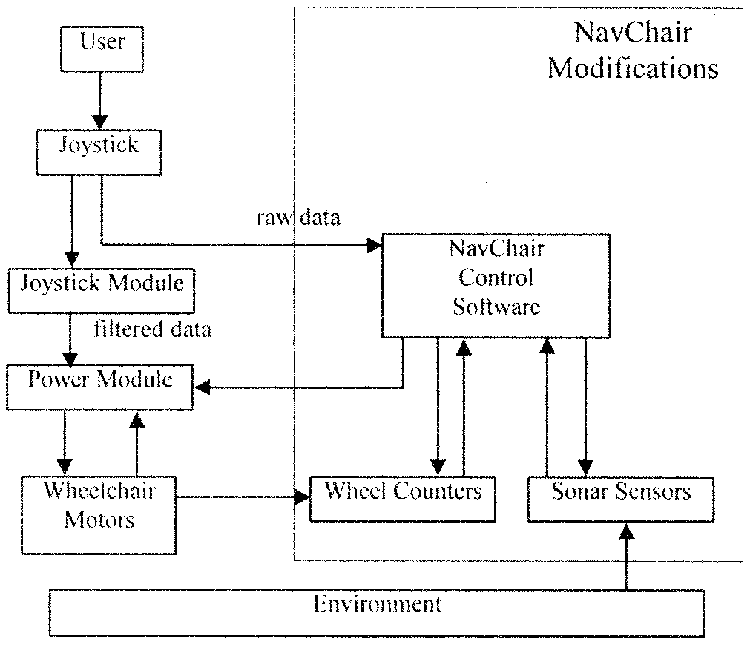
Existing System
The NavChair Assistive
Wheelchair Navigation System:

Slide 9
Input from the sonar sensors and wheel motion sensors is used to update a Cartesian map (referred to as the certainty grid) centered around the chair. The map is divided into small cells, each of which contains a count of the number of times a reading has placed an object within that cell. The count within each cell, the certainty value, represents the probability that an object is within that cell; so the more often an object is seen within a cell the higher its certainty value.
The certainty grid is converted into a polar histogram, centered on the vehicle, that maps obstacle density (a combined measure of the certainty of an object being within each sector of the histogram and the distance between that object and the wheelchair) versus directionof travel [6], [7].
The polar histogram is searched for a direction of travel that is as close as possible to the target direction indicated by the user, while also having an obstacle density beneath a predetermined safety threshold.

Slide 10
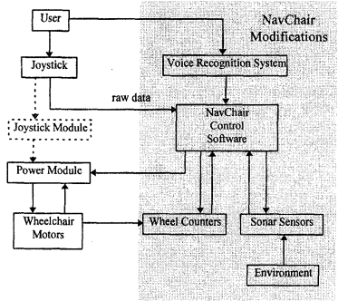
2. Adaptive Shared Control of a Smart Wheelchair Operated by Voice Control:

Slide 11
The NavChair's voice control facility is based on the Verbex Speechcommander*, a commercially-available continuous-speech voice recognition system that relays user commands to the NavChair via the computer's serial port. Prior to operation,users train the Speechcommander to identify a small set of commands, a process which is typically accomplished in less than ten minutes. During operation, the user speaks a command into the Speechcommander’s microphone, worn on a headset. The Speechcommander identifies the sound signal as one of the pre-trained commands and transmits a computer code associated with that command to the NavChair’s computer. The NavChair’s computer matches the signal from the Speechcommander to a specific joystick command which is then used to steer the chair. The NavChair provides task-specific navigation assistance in the form of several distinct operating modes, each of which distributes control differently between the wheelchair and the operator.
Each operating mode determines how control is allocated through (1) the combination of obstacle avoidance techniques it uses and (2) the operaring parameters it chooses for each obstacle avoidance technique [I]. Depending on the settings chosen for minimum required obstacle clearance, maximum velocity, and other parameters, the operator and the NavChair are given varying amounts of control over the wheelchair ‘s direction and speed. Currently, operating modes are implemented for collision-free travel in open environments (General Obstacle Avoidance mode), passage through doorways or between closely spaced obstacles (Door Passage mode), and navigation near to, and guided by, hallway walls (Automatic Wall Following mode). Each of these operating modes makes use of a distinct (though intersecting) set of obstacle avoidance routines, which uniquely determines each mode’sbehavior.

Slide 12
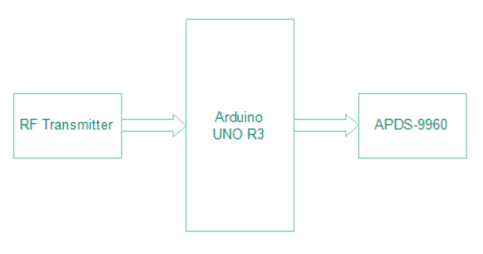
Proposed System
In this remote system we added rf Transmitter which is connected with Arduino, it has gesture Sensor which is controlled for sensing direction of chair. RF transmitter share signal upto 500 meter. It is placed on the chair.

Slide 13
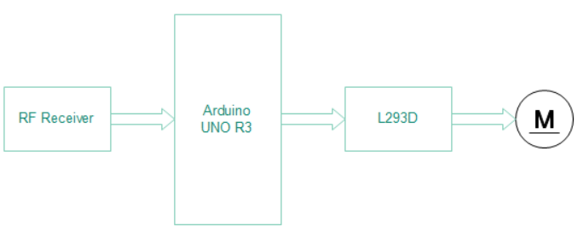
Rf Receiver receive signal from remote and forward towards the Arduino and motor rotate using this signal.

Slide 14
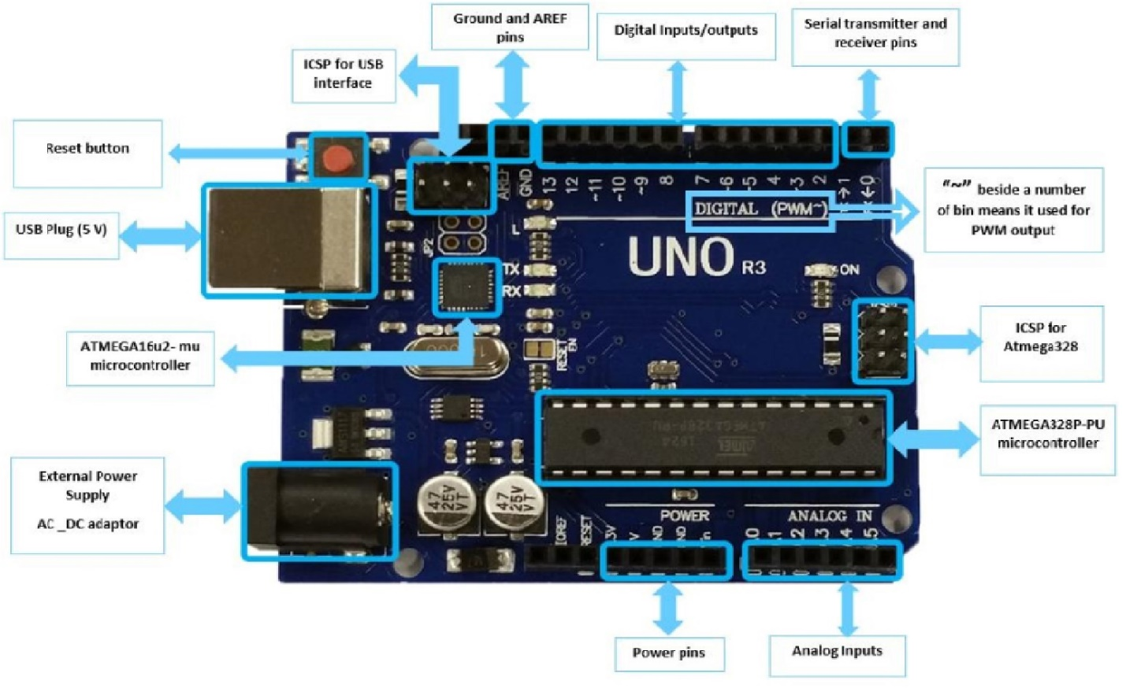
Arduino UNO r3

Slide 15
Arduino is a single-board microcontroller meant to make the application more accessible which are interactive objects and its surroundings. The hardware features with an open-source hardware board designed around an 8-bit Atmel AVR microcontroller or a 32-bit Atmel ARM. Current models consists a USB interface, 6 analog input pins and 14 digital I/O pins that allows the user to attach various extension boards.
The Arduino Uno board is a microcontroller based on the ATmega328. It has 14 digital input/output pins in which 6 can be used as PWM outputs, a 16 MHz ceramic resonator, an ICSP header, a USB connection, 6 analog inputs, a power jack and a reset button. This contains all the required support needed for microcontroller. In order to get started, they are simply connected to a computer with a USB cable or with a AC-to-DC adapter or battery. Arduino Uno Board varies from all other boards and they will not use the FTDI USB-to-serial driver chip in them. It is featured by the Atmega16U2 (Atmega8U2 up to version R2) programmed as a USB-to-serial converter.

Slide 16
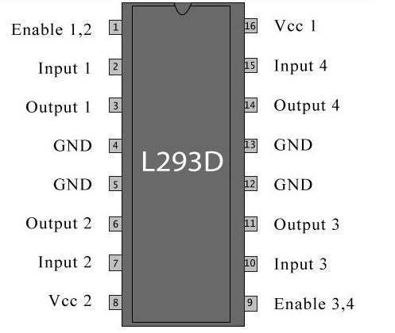
L293D

Slide 17
The L293D is a popular 16-Pin Motor Driver IC. As the name suggests it is mainly used to drive motors. A single L293D IC is capable of running two DC motors at the same time; also the direction of these two motors can be controlled independently. So if you have motors which has operating voltage less than 36V and operating current less than 600mA, which are to be controlled by digital circuits like Op-Amp, 555 timers, digital gates or even Micron rollers like Arduino, PIC, ARM etc.
All the Ground pins should be grounded. There are two power pins for this IC, one is the Vss (Vcc1) which provides the voltage for the IC to work, this must be connected to +5V. The other is Vs (Vcc2) which provides voltage for the motors to run, based on the specification of your motor you can connect this pin to anywhere between 4.5V to 36V, here I have connected to +12V.
The Enable pins (Enable 1,2 and Enable 3,4) are used to Enable Input pins for Motor 1 and Motor 2 respectively. Since in most cases we will be using both the motors both the pins are held high by default by connecting to +5V supply. The input pins Input 1,2 are used to control the motor 1 and Input pins 3,4 are used to control the Motor 2. The input pins are connected to the any Digital circuit or microcontroller to control the speed and direction of the motor. You can toggle the input pins based on the following table to control your motor.

Slide 18
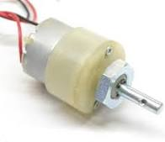
DC Motor

Slide 19
Typical brushless DC motors use one or more permanent magnets in the rotor and electromagnets on the motor housing for the stator. A motor controller converts DC to AC. This design is mechanically simpler than that of brushed motors because it eliminates the complication of transferring power from outside the motor to the spinning rotor. The motor controller can sense the rotor's position via Hall effect sensors or similar devices and can precisely control the timing, phase, etc., of the current in the rotor coils to optimize torque, conserve power, regulate speed, and even apply some braking. Advantages of brushless motors include long life span, little or no maintenance, and high efficiency. Disadvantages include high initial cost, and more complicated motor speed controllers. Some such brushless motors are sometimes referred to as "synchronous motors" although they have no external power supply to be synchronized with, as would be the case with normal AC synchronous motors.
This DC Motor – 10RPM – 12Volts can be used in all-terrain robots and a variety of robotic applications. These motors have a 3 mm threaded drill hole in the middle of the shaft thus making it simple to connect it to the wheels or any other mechanical assembly.

Slide 20
AD9960
The APDS9960 is used in many places. We can use it for gesture detection, ambient and RGB light sensing, proximity sensing etc. It can be used to give the RGB ratings of the light, because many times we need a particular RGB rated light, so that can be manipulated accordingly. It is used in many phones to disable the screen while someone is dialing the phone and keeping it on ear.
The sensor uses I2C communication protocol so that makes it super easy to use with microcontrollers. It operates on voltage range of 2.4V-3.6V (Typically 3.3V) and consumes really small current of 0.2mA so it is a power efficient sensor. The sensor gives the RGB values directly so you don’t need to do any calculations to fetch them.
Hardware of this sensor module is very simple. APDS9960 sensor is the main component for this board. As the board operates on 3.3V so a voltage regulator is used. The sensor has four photodiodes to detect the gestures. Whenever a gesture is performed, the IR signal transmitted by the LED gets reflected by the obstacle and is detected by the photodiodes and then the information is received about velocity and distance. This is how a gesture is detected. For RGB color sensing it has different channels for each kind of light red, blue, green and clear. And each channel has IR and UV blocking filters and a data converter which produces 16-bit data for each channel. This sensing can be used to calculate color temperature and can also be used to manipulate the backlight of displays. The interrupt is used to control the detect function. So it triggers the sensor to release the IR or detect it according to the interrupt.

Slide 21
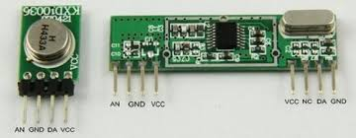
RF transmitter and receiver

Slide 22
In general, the wireless systems designer has two overriding constraints: it must operate over a certain distance and transfer a certain amount of information within a data rate. The RF modules are very small in dimension and have a wide operating voltage range i.e. 3V to 12V.
Basically the RF modules are 433 MHz RF transmitter and receiver modules. The transmitter draws no power when transmitting logic zero while fully suppressing the carrier frequency thus consume significantly low power in battery operation. When logic one is sent carrier is fully on to about 4.5mA with a 3volts power supply. The data is sent serially from the transmitter which is received by the tuned receiver. Transmitter and the receiver are duly interfaced to two microcontrollers for data transfer.
As compared to the other radio-frequency devices, the performance of an RF module will depend on several factors like by increasing the transmitter’s power a large communication distance will be gathered. However, which will result in a high electrical power drain on the transmitter device, which causes a shorter operating life of the battery-powered devices. Also by using this device at higher transmitted power will create interference with other RF devices.
In many projects, we use RF modules to transmitting and receive the data because it has a high volume of applications than IR. RF signals travel in the transmitter and receiver even when there is an obstruction. It operates at a specific frequency of 433MHz.

Slide 23
Implementation and Result

Slide 24
Conclusion
This work presents the design of a low-cost, smart wheelchair prototype. The controllability of the wheelchair is increased via the use of simple technologies: Gesture Control. The low-complexity speech recognition system design resulted in an impressive recognition rate of 98%. The user can also turn chair in 4 direction i.e. left, right, forward and backward. The user can also control the speed of the wheelchair. In conclusion, the system can offer a set of useful features to assist the mobility of the disabled people.

